Slide 1

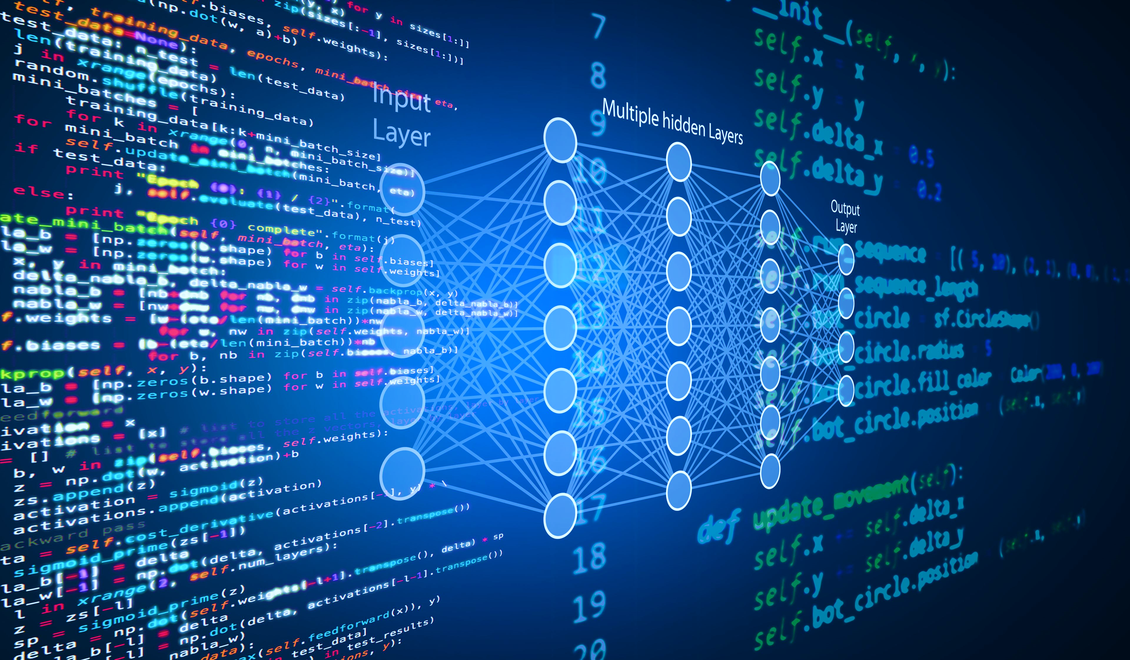

HIT 140 FOUNDATIONS OF DATA SCIENCE Group Number 106
Shishiranjan Thakur (371465)
Rishika Shrestha (371778)
Sheetu Prakash Nakarmi (369887)
Ashma Bhandari (370896)

Slide 2
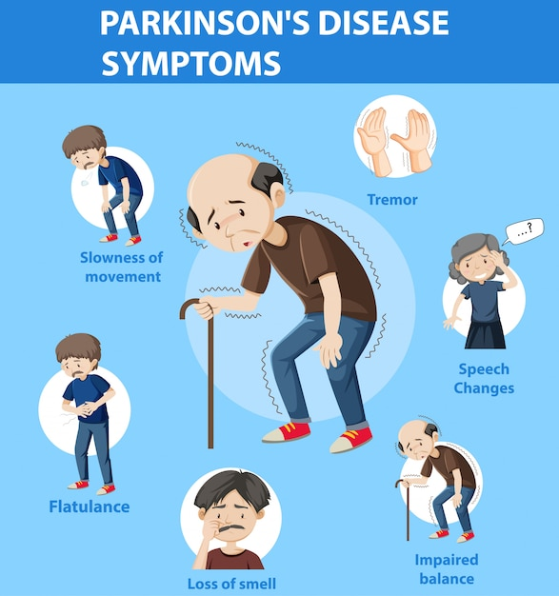
INTRODUCTION
Parkinson’s disease is a ‘movement disorder of the nervous system that gets worse over time’.
It causes unintended or uncontrollable movements, such as shaking, stiffness, and difficulty with balance and coordination.
Its common symptoms are tremors, rigidity, bradykinesia, and postural instability.
There are notable figures who suffered from PD include the legendary boxer Muhammad Ali, the former U.S. president George H.W. Bush, the Back to the Future actor Michael J. Fox, the heavy metal legend Ozzy Osbourne, and the late Pope John Paul II.
(Denison, 2023)
(Src: Freepik Company S.L. , 2010-2023)

Slide 3
INTRODUCTION (Contd.)
Since there is no effective treatment for Parkinson's disease, but interest in finding a cure is growing.
Analyzing a person's speech data acquired from various kinds of sound recordings is one way that might be possible approach to cure it. Through the non-invasive analysis of a person's voice's numerous frequency-based properties, symptoms can be identified.

Slide 4
ANALYZATION OF DATASET
Dataset 1, which is po1_data.txt, is a data that focuses on analyzing a set of acoustic measurement data extracted from the voice samples of people suffering from Parkinson’s and, from those who were healthy.
The main objectives of this analysis are to examine the effects of Parkinson's disease on a limited collection of Jitter and Shimmer voice indicators and to compare the speech patterns of men and women in noisy and quiet environment.

Slide 5
ANALYZATION OF DATASET (Contd.)
Total data collection from age 36 to 85 : 40
The one who suffer from Parkinson : 20
The one who are healthy : 20
Total voice samples extracted from each individual : 26
Feature for each sample:
Jitter
Shimmer
Harmonicity
Pitch
Pulse
Voice

Slide 6
ANALYZATION OF DATASET (Contd.)
To measure above features, a rating scale was used called as the Unified Parkinson’s Disease Rating Scale (UPDRS). The UPDRS score that is assigned to the subject by a physician via a medical examination to determine the severity and progression of Parkinson’s disease.
The Parkinson’s Disease Indicator:
Value “1” indicates a subject suffering from PD
Value “0” indicates a healthy subject.

Slide 7
JITTER
The jitter variables measure the variation in the frequency of the sound.
Jitter | In percentage
Absolute jitter | In microseconds (µs)
Jitter | Relative amplitude perturbation (r.a.p.)
Jitter | 5-point period perturbation quotient (p.p.q.5)
Jitter | average absolute difference of differences between jitter cycles (d.d.p.)
Our analysis was based on sample ‘2’.
(Denison, 2023)
Sakar, B.E. et al. (2013).

Slide 8
SHIMMER
The shimmer variables measure the variation in the amplitude of the sound.
Shimmer | In percentage
Absolute Shimmer | In decibels (dB)
Shimmer | 3-point amplitude perturbation quotient (a.p.q.3)
Shimmer | 5-point amplitude perturbation quotient (a.p.q.5)
Shimmer | 11-point amplitude perturbation quotient (a.p.q.11)
Shimmer | average absolute differences between consecutive differences between the amplitudes of shimmer cycles (d.d.a.)
(Denison, 2023)
Sakar, B.E. et al. (2013).

Slide 9
HARMONICITY
The harmonicity variables are related to vocal quality and assess the noise in the sound.
Harmonicity | Noise-to-Harmonic ratio (NHR)
Harmonicity | Harmonic-to-Noise ratio (HNR)
Harmonicity | Autocorrelation between NHR and HNR
(Denison, 2023)
Sakar, B.E. et al. (2013).

Slide 10
PITCH
The pitch variables measure how high or low is the sound based on the frequency of vibration of the sound waves produced.
Pitch | Median
Pitch | Mean
Pitch | Standard Deviation
Pitch | Minimum
Pitch | Maximum
(Denison, 2023)
Sakar, B.E. et al. (2013).

Slide 11
PULSE
The pulse variables measure the glottal pulse, which are variances in voice quality affected by manipulating the vocal cords when speaking.
Pulse | Number of pulses
Pulse | Number of periods
Pulse | Mean period
Pulse | Standard deviation of period
(Denison, 2023)
Sakar, B.E. et al. (2013).

Slide 12
VOICE
The voice variables measure the extent to which a subject has trouble maintaining vocal cord vibration when saying a sustained vowel.
Voice | Fraction of unvoiced frames
Voice | Number of voice breaks
Voice | Degree of voice breaks
(Denison, 2023)
Sakar, B.E. et al. (2013).

Slide 13
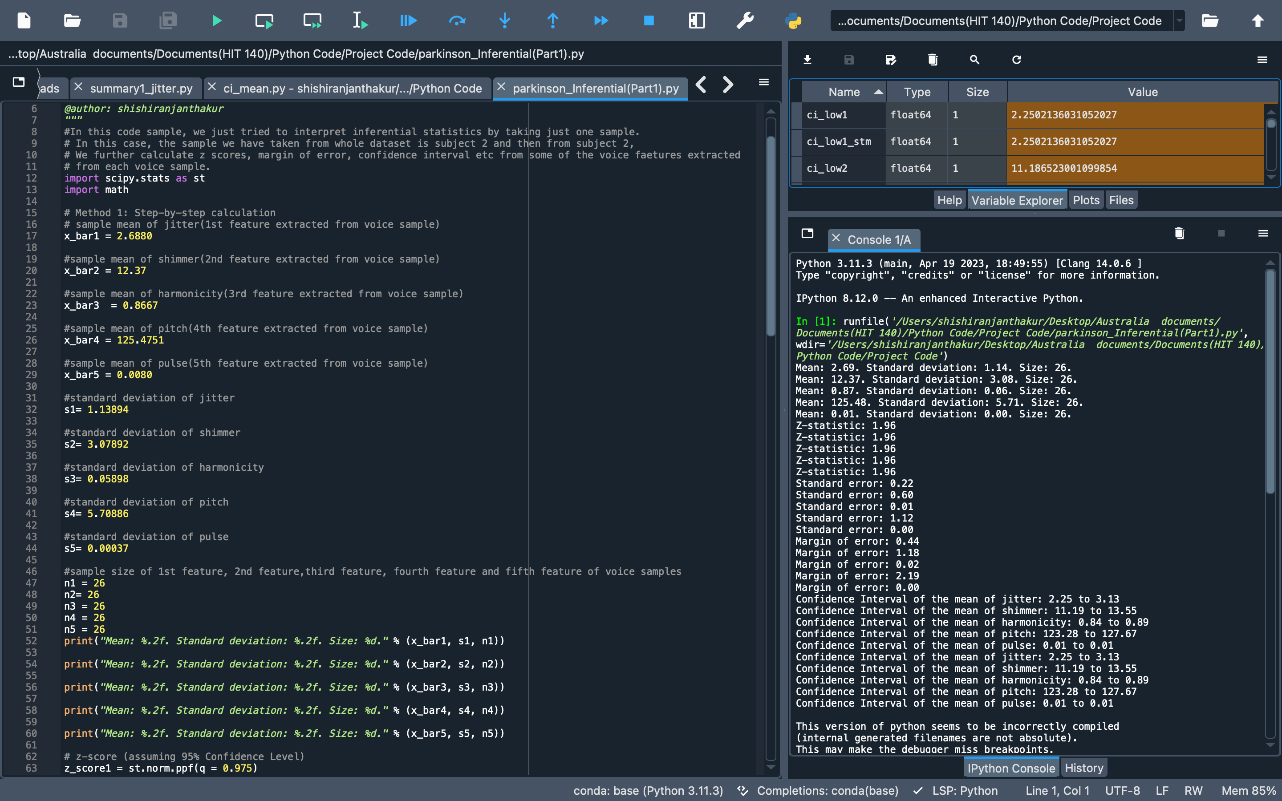

Slide 14
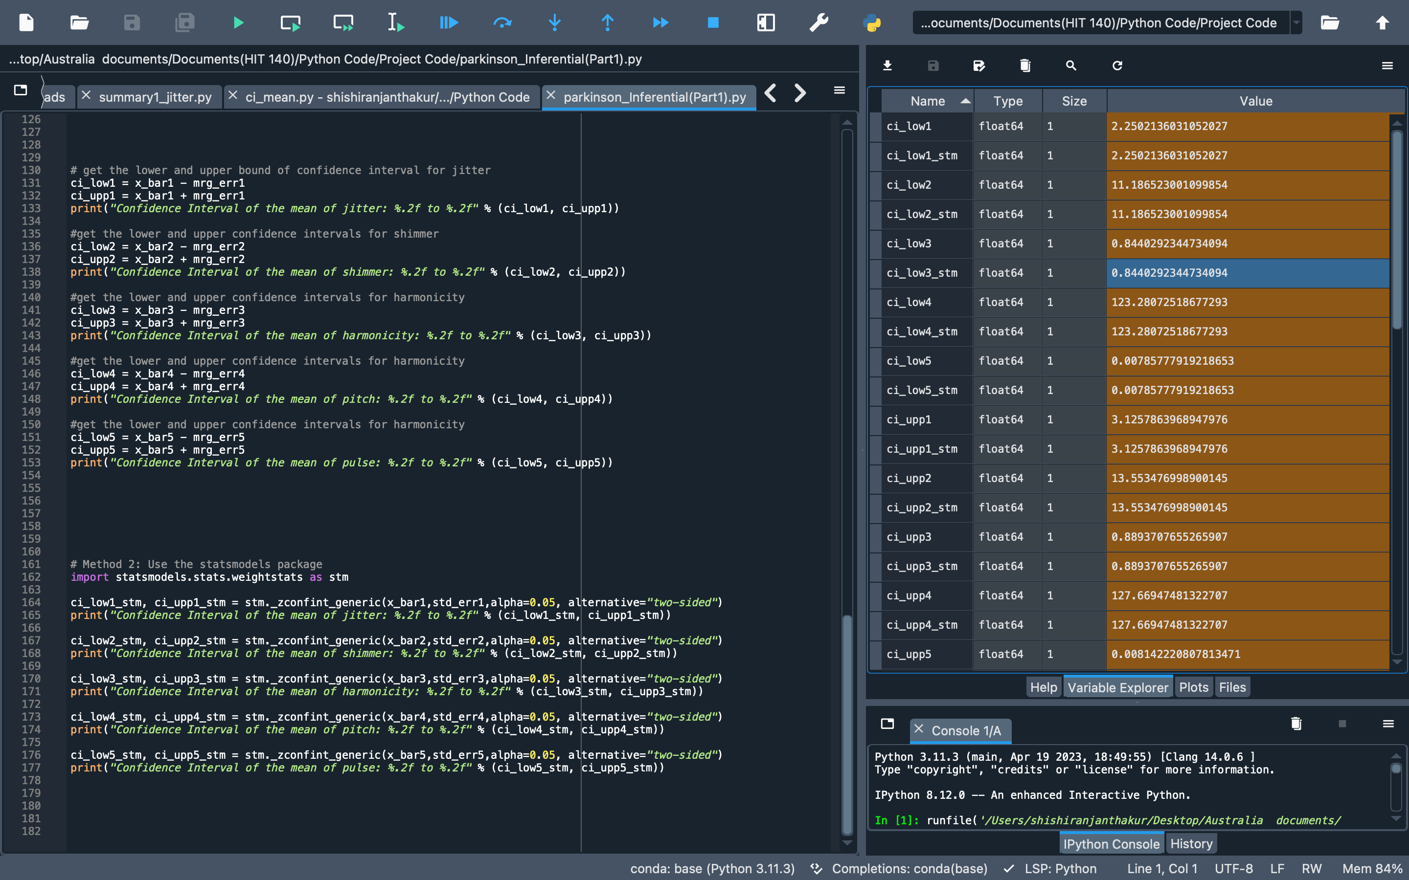
Output demonstrating the concept of inferential statistics Example: z-score, confidence interval, standard error, margin of error

Slide 15
FRAMEWORK USED FOR DATA ANALYSIS
Panda : used for Data Wrangling
Scipy.stats : used for probabilistic distributions and statistical operations
Seaborn : used for enhancing data visualization
Math library : Used as a set of built-in math functions, including an extensive math module, that allows you to perform mathematical tasks on numbers.

Slide 16
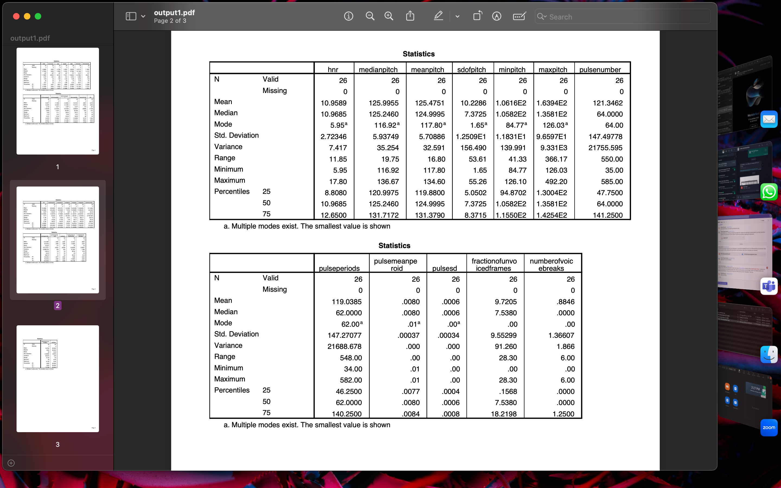

Slide 17
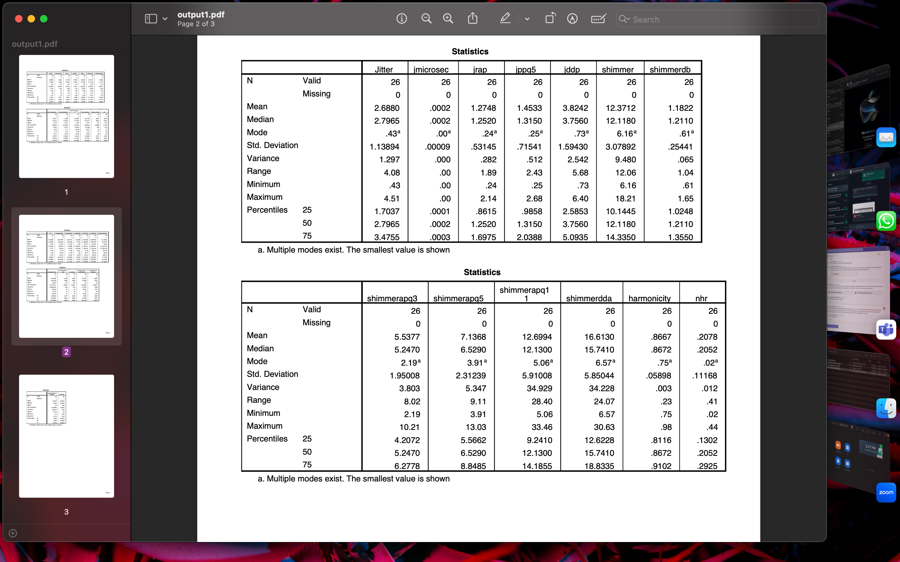

Slide 18
CONCLUSION
Key Information is Contained in Sustained Vowels
Compared to single words and sentences, sustained vowels provide more PD-discriminative info.
Metrics Analysis
For data representation, metrics for central tendency and dispersion were investigated.
Standard Deviation and Mean Stand Out
The use of mean and standard deviation improves the generalization of prediction models.
Summarizing Beats Individual
Mean and standard deviation summaries are preferable than individual data samples.
Effective Prediction Models
With numerous recordings per participant, models that use the mean and standard deviation of vocal features enhance prediction accuracy.

